Slide 1
Accessing TCGA Data

Slide 2
Access Tiers of TCGA data
Open Access
Controlled Access
Non-identifiable data
Aggregate data
Gene level summaries
Any one can download, free to share
Identifiable Data
Raw sequence data
Raw SNP data
Must apply for access through dbGaP with eRA Commons account – Students/postdocs have access under their PI
Data cannot be shared across labs
https://gdc.cancer.gov/access-data/data-access-policies
https://gdc.cancer.gov/access-data/obtaining-access-controlled-data/registering-and-working-era-commons-and-dbgap

Slide 3
Genome Data Commons – https://gdc.cancer.gov
New Harmonized
Data – mapped to
Hg38
Different pipelines
Than prior TCGA
data

Slide 4
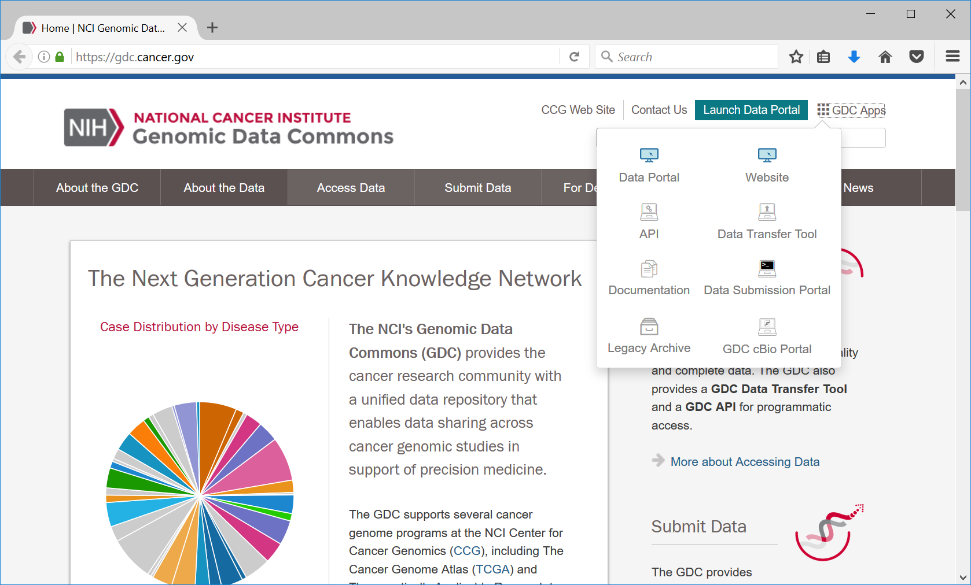
Genome Data Commons– https://gdc.cancer.gov
Prior TCGA data from
DCC and CGHub
Hg19 aligned data

Slide 5
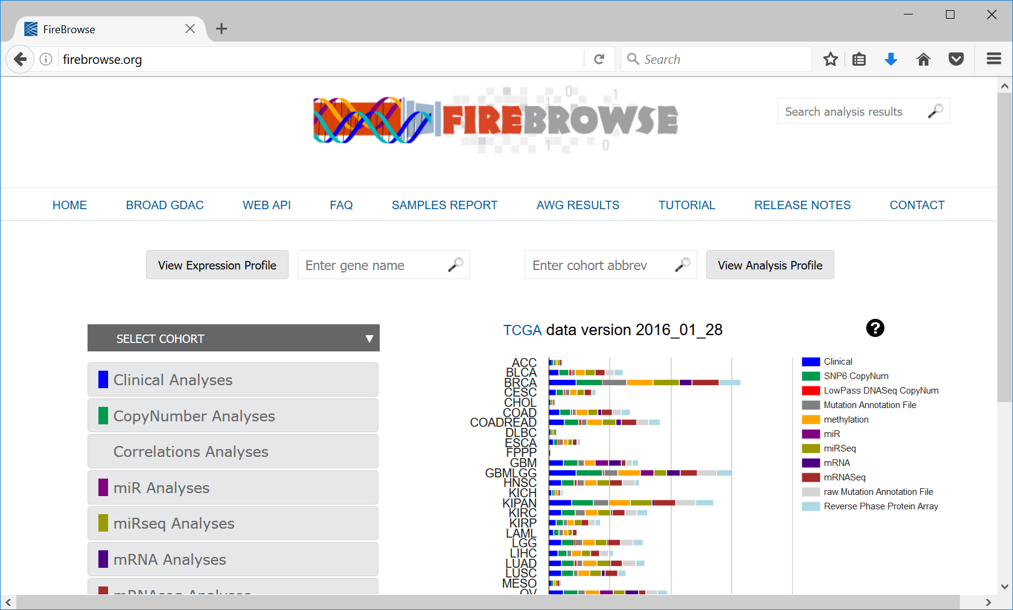
Firebrowse – http://www.firebrowse.org

Slide 6
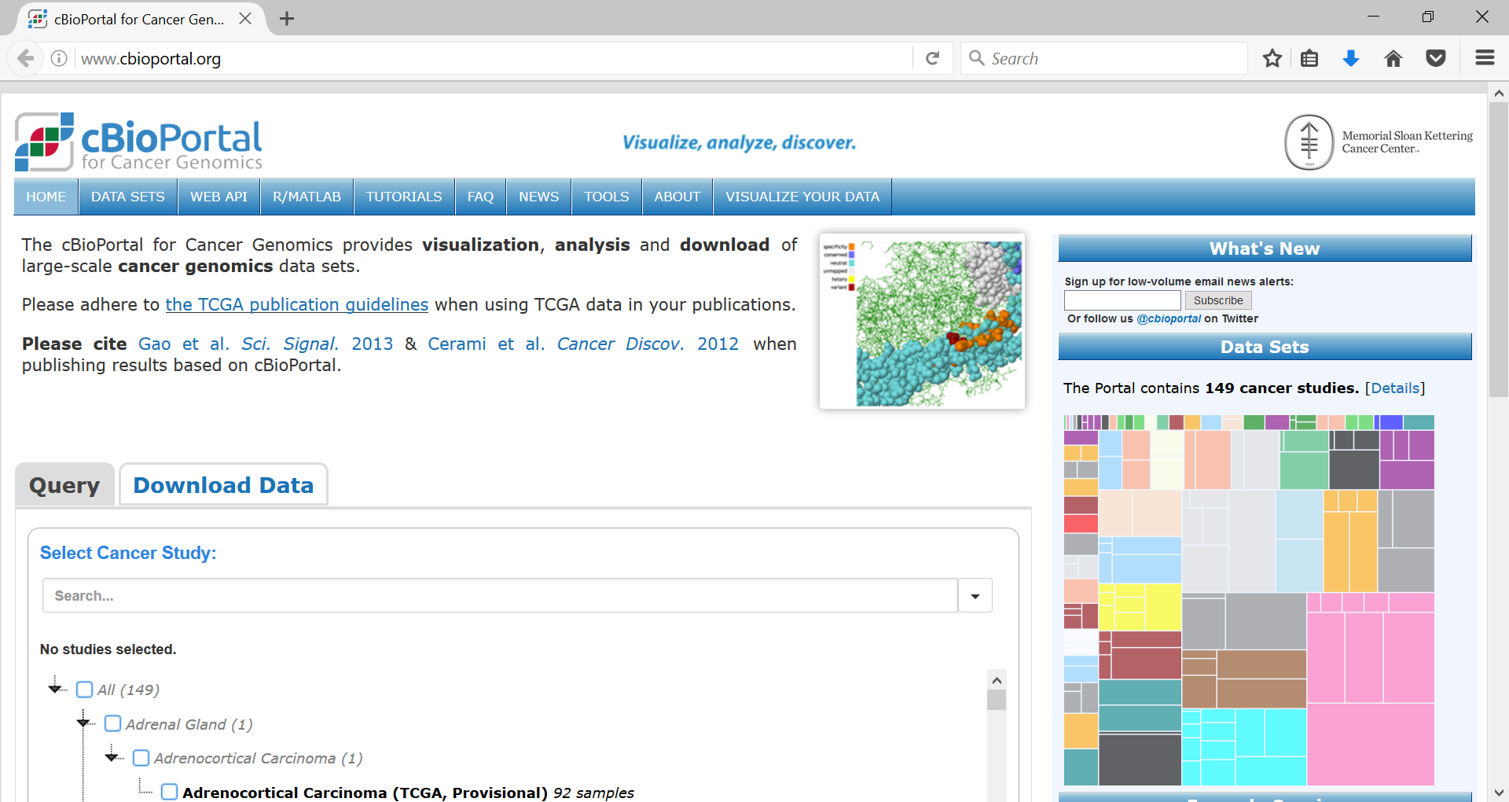
CbioPortal – www.cbioportal.org

Slide 7
TCGA Breast Cancer Genomic Data Sites
https://tcga-data.nci.nih.gov/docs/publications/brca_2015/ (all open access TCGA Breast Cancer Data)
https://lbg.unc.edu/~hoadley/BRCA.817.rsemg.uqnorm.counts.txt (all 20,000 gene expression values)
https://lbg.unc.edu/~hoadley/BRCA.817.rsemg.uqnorm.counts.intrinsic.txt (~2000 gene “classification list”)

